Slide 1
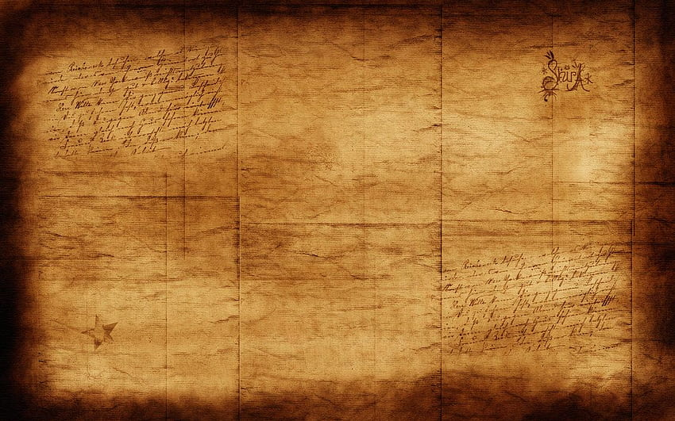
Topic - Discovering Ancient India: The Experience of Foreign Travelers.
Raghunath Roy
Assistant Professor of History
Government General Degree College, Tehatta

Slide 2
List of Foreign Travelers in Ancient India
Traveler | Time/Period | Role/ Title | Notable Works/Contributions
Megasthenes | 302-298 B.C | Greek Ambassador | “Indika”: Descriptive account of ancient India, including geography.
Ptolemy | 130 A.D | Greek Geographer | “The Geography of India”: Describes ancient Indian geography
Faxian | A.D 405-411 | Chinese Wayfarer | “Record of Buddhist Kingdom”: Details about Gupta dynasty and social-economic spheres
Xuanzang | 630 A.D | Chinese Traveler | Stayed 15 years during Harsha Vardhana’s rule – “Si-Yu-Ki” (The Records of Western World): Studied caste system and more.
I-TSING | 671-695 A.D. | Chinese Traveler | Visited India in connection with Buddhism – Works include biographies of important monks.

Slide 3
Megasthenes: Indika

Slide 4
Ptolemy

Slide 5
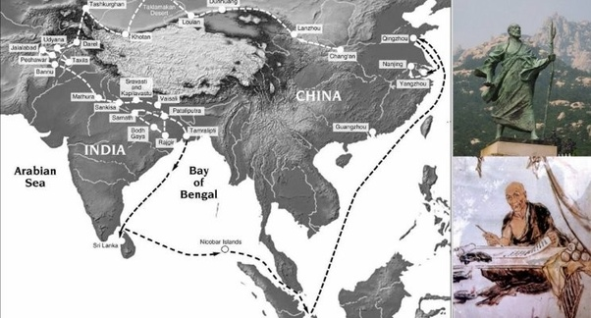
Faxion:

Slide 6
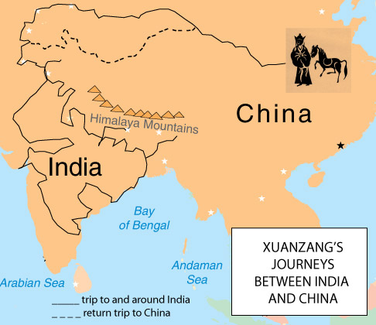
Xuanzang

Slide 7
I-Tsing

Slide 8
Raghunath Roy Assistant Professor of History Government General Degree College, Tehatta
Thank You

